Slide 1
Thank you for your interest in sharing results from the Community College Health Study with your network. This NIH-funded study aims to better understand how to provide resources and programming to enhance the sexual and relationship health of community college students and prevent sexual assault.
The following slides are for you to use when you are sharing information about the study with other members of your college, organization or network. You can copy and paste these slides into an existing presentation or present these slides as standalones. As a reminder, when sharing this information, please cite these slides using Brewington, M., Evans-Paulson, R., Porter, E. Scull, T. and The Community College Health Study Team (2023). Community College Health Study Newsletter, 4th edition. https://cchealthstudy.com.
If you have any questions, please feel free to email our study coordinator at CCHstudy@irtinc.us.
Thank you,
The Community College Health Study team
© 2023 Innovation Research and Training, Inc.

Slide 2
As a part of the Community College Health Study, over 1,500 community college students from 34 college campuses across the nation are completing online questionnaires about their sexual health, relationships, media use, and previous experiences with sexual health education.
This study is being conducted by researchers at innovation Research & Training (iRT).
Find more information:
Visit the study website at https://cchealthstudy.com
Email the study team at CCHStudy@iRTinc.us
Funding for this study was provided by the Eunice Kennedy Shriver National Institute of Child Health and Human Development of the National Institutes of Health (NIH) under award number R01HD099134 to Dr. Tracy M. Scull. Research reported in this newsletter is solely the responsibility of the authors and does not necessarily represent the official views of the NIH
© 2023 Innovation Research and Training, Inc.
Notes:
innovation Research & Training (iRT) is a behavioral sciences research company that employs a diverse term of research scientists, web applications developers, and other specialists. iRT focuses on developing and disseminating evidence-based programs. More information about the company can be found at https://irtinc.us/.

Slide 3
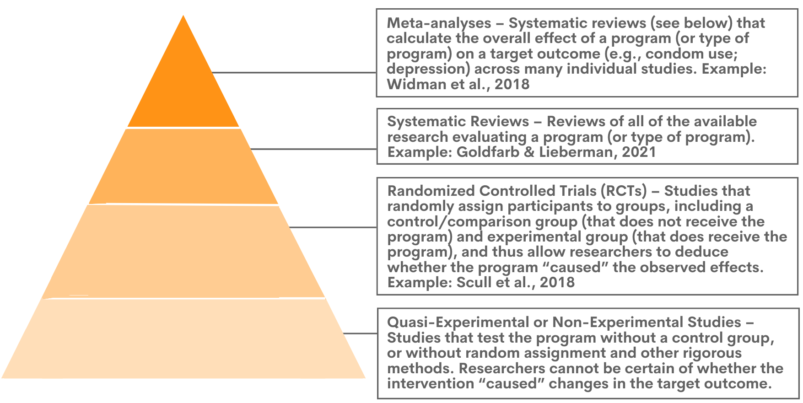
An evidence-based program is an intervention or curriculum that has been rigorously evaluated—such as through experimental studies—and found to have a positive impact on a target population’s outcomes.
What are evidence-based programs and why are they important?
To identify high quality evidence, researchers and practitioners often refer to a hierarchy of study types based on the strength of the evidence they produce—in other words, how reliable their results are in evaluating how well a program works.
By carefully selecting evidence-based programs for students, colleges can be reasonably confident that these programs will work and, thus, be beneficial to the health and wellbeing of their students.
© 2023 Innovation Research and Training, Inc.
Notes:
The evidence quality pyramid was adapted from the following resource:
Duquesne University (2023). "Evidence-Based Medicine & Practice." Duquesne University. Accessed August 8, 2023 from https://guides.library.duq.edu/clickablepyramid/home
In addition, the original creation of the evidence-based medicine pyramid is credited to the following:
EBM Pyramid and EBM Page Generator, copyright 2006 Trustees of Dartmouth College and Yale University. All Rights Reserved. Produced by Jan Glover, David Izzo, Karen Odato and Lei Wang. EBM Resource Pyramid.

Slide 4
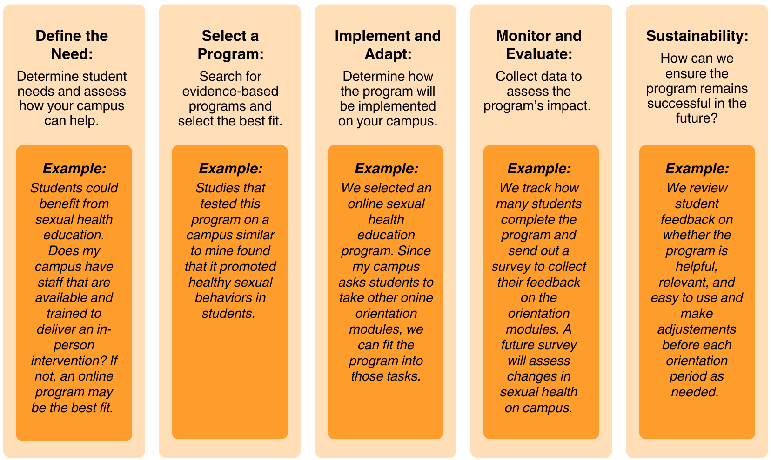
The steps and examples below offer some simple guidelines to ensure colleges choose the right evidence-based program for their students when it comes to promoting health and wellness.
How should colleges select and implement evidence-based programs?
© 2023 Innovation Research and Training, Inc.
Notes:
Information on steps for selecting and implementing evidence-based programs was gathered from the following resource:
Youth.gov (2023). "Using Evidence to Improve Outcomes." Youth.gov. Accessed August 8, 2023 from https://youth.gov/evidence-innovation

Slide 5
Several agencies offer grant funding for organizations—like community colleges—to implement evidence-based programs focused on specific health issues or populations.
Where can colleges find support for implementing evidence-based programs for students?
Some organizations, like innovation Research & Training (iRT), focus on developing evidence-based programs for schools, colleges, and other organizations to use with their communities. Some of iRT’s evidence-based programs for college students include:
Media Aware is an online, media literacy education-based sexual health education program for young adults that leverages college students’ passion for pop culture to teach medically-accurate sexual health information and behavioral skills to prevent sexual assault, sexually transmitted infections, and unplanned pregnancy.
Plan My Ride is a comprehensive, eLearning safe driving education program designed for new drivers, including but not limited to college students. Through the interactive program, young people learn about the risks of impaired and distracted driving and build skills to prevent it.
Connected Scholars is an instructor-led, semester-long course designed to teach high school and college students the rarely taught relationship- and network-building skills needed for academic, social, and career success.
© 2023 Innovation Research and Training, Inc.

